Slide 1


TRiCAM QRI Project Presentation
MICHELLE YANG, AKASH LEVY, ALBERT TUNG, JANETTE GARCIA

Slide 2
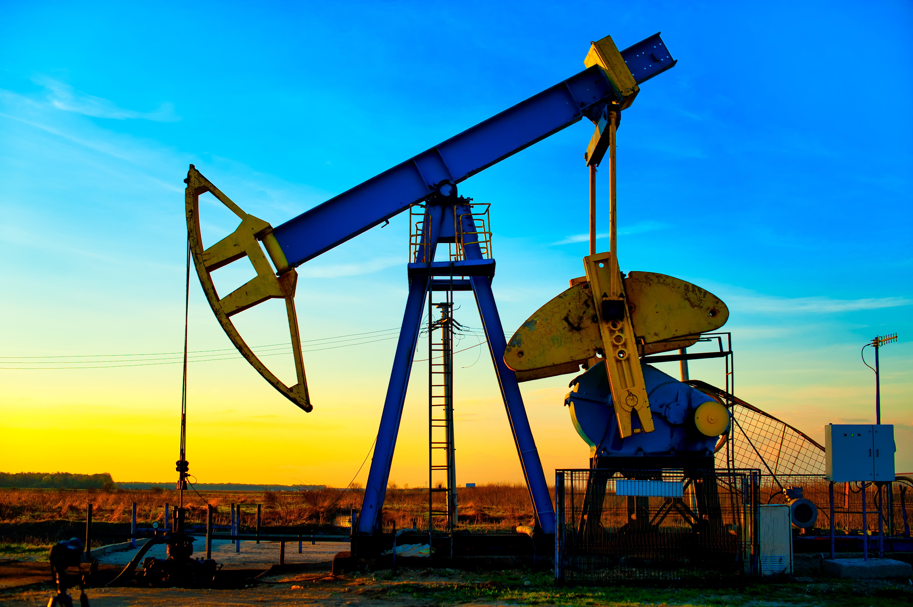
QRI Problem Summary
Goal: predict oil production rate in petroleum wells
Strategy: deep learning
Models:
Convolutional Neural Network (CNN)
Multilayer Perceptron (MLP)
Recurrent Neural Network (RNN)
Restricted Boltzmann Machine (RBM)

Slide 3
QRI Data - Preprocessing

Slide 4
Recurrent Neural Networks (RNN)

Slide 5
Restricted Boltzmann Machines (RBM)

Slide 6
Autoencoders

Slide 7
Convolutional Neural Network (CNN)

Slide 8
Training on QRI Data
Convolutional Neural Network (CNN)
Multilayer Perceptron (MLP)

Slide 9
Thank you!
Questions?

Slide 10
Works Cited
Picture slide 2: http://www.sfltimes.com/wp-content/uploads/2015/06/oil-drilling-at-sunset.jpg

